Slide 1
Aasee Website Content

Slide 2



Home Page Content
Header Content:
Home Our Purpose Infrastructure Product Line Accreditations Contact Us (Get in Touch Bubble)
Home Page Content:
About Us
Product Line (Product category images, and the product line title connects to Product Line Page)
Our Expertise
Contact Us
Home Page Header - https://pukraexports.com/ (Please add that Get in Touch/Talk to us option where it connects to the mail-id info@aaseeexport.com)

Slide 3
Home Page - About Us
Company Introduction :
Aasee Export is a leading manufacturer and exporter of home textiles based in Karur, South India. The company specializes in Cotton and Linen fabrics that are thoughtfully crafted into cushion covers, seat pads, table linen and kitchen linen.
Established in 1995, the company operates with its own integrated dyeing and weaving units, enabling close monitoring of production while ensuring consistent quality and reliable timelines.
Home Page Header - https://pukraexports.com/ (Please add that Get in Touch/Talk to us option where it connects to the mail-id info@aaseeexport.com)

Slide 4
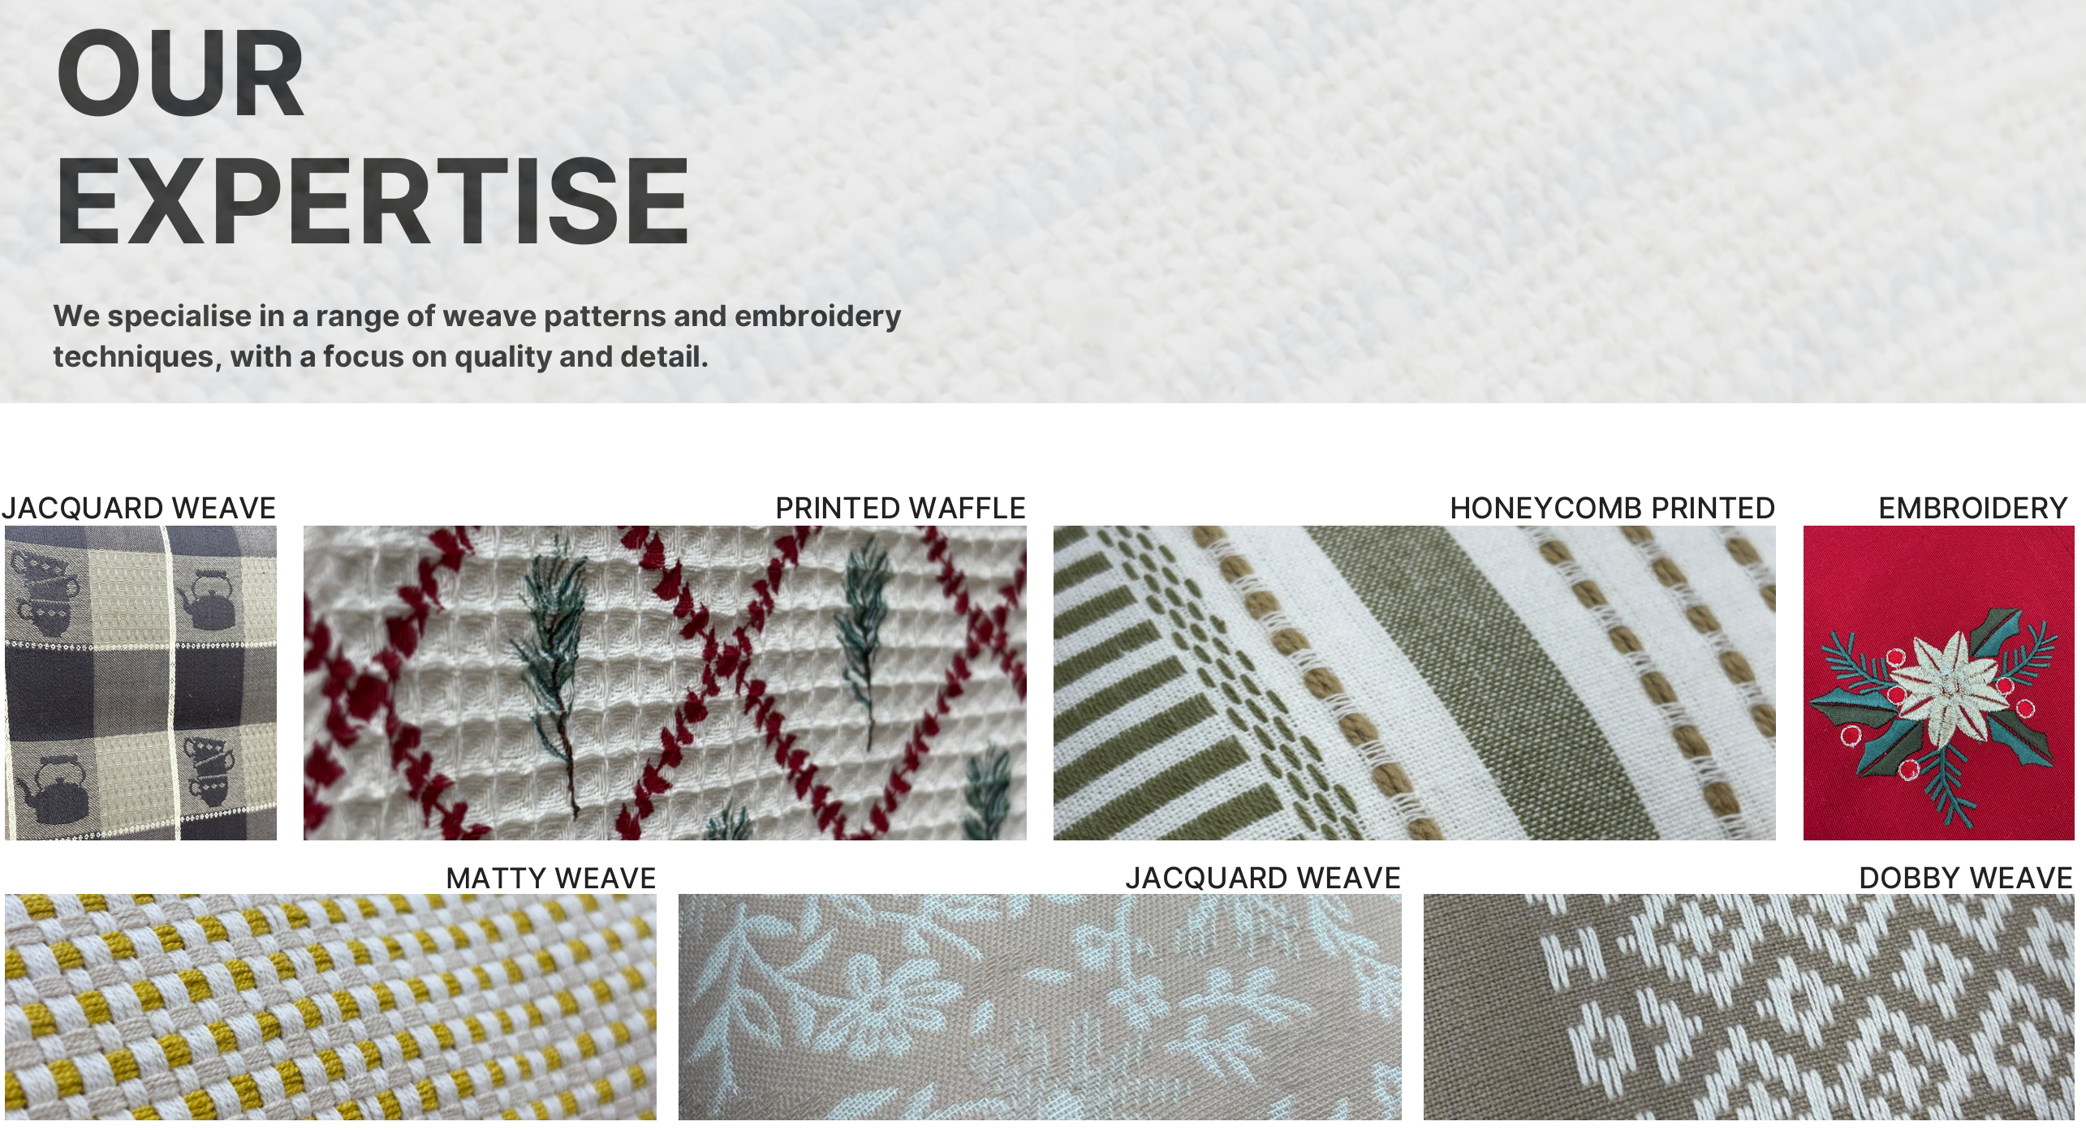
Home page
Make similar collage for expertise in the Home Page along with the text. I have attached the images in the Home Page folder in images

Slide 5
Our Purpose
Vision:
To leverage our decades of manufacturing expertise to develop distinctive home-textile creations and expand our global presence through innovation, quality, and scale.
Mission:
Our mission is to be a trusted home-textile manufacturing partner by delivering consistent quality, maintaining reliable production timelines, and providing responsive service to meet the evolving expectations of customers worldwide

Slide 6
Our purpose - Core Values
Empowering the working community:
We believe our people are the foundation of our success. We are committed to providing a safe, respectful, and supportive work environment where our workforce is valued, cared for, and empowered to contribute their best.
Adaptability and Innovation:
We embrace creativity and remain open to exploring new designs and product ideas. By encouraging fresh perspectives and collaborative development, we work closely with our customers to co-create innovative home-textile creations

Slide 7
Core Values
Reliability and Transparency:
We build long-term relationships through honesty, transparency, and open communication. By understanding our customers’ requirements, we strive to consistently meet their expectations in quality standards and production timelines.
Sustainability:
We are committed to responsible manufacturing practices by working primarily with natural fibers such as cotton and linen and maintaining a clean supply chain. We also incorporate recycled materials, including recycled cotton and polyester, to support more sustainable production.

Slide 8
infrastructure
Introduction:
Aasee Export operates a fully equipped manufacturing facility spread across 8 acres, supported by a dedicated workforce of over 200 skilled personnel.
Our integrated infrastructure includes specialized units for in-house hank dyeing, weaving looms, checking, finishing, stitching, and packaging, including vacuum packing. This streamlined manufacturing setup allows us to closely monitor every stage of the production process, ensuring consistent quality, operational efficiency, and adherence to international standards.

Slide 9
infrastructure
Dyeing:
We have a fully integrated in-house Hank Dyeing facility capable of dyeing 90,000 kg of yarn every month.
The unit is supported by an advanced sewage treatment plant that enables zero effluent discharge, ensuring responsible and eco-conscious production.
Reference : https://rcm-organic.co/our-capabilities/#our-verticals (Similar to In-house processes in this page)

Slide 10
infrastructure
Weaving:
Weaving looms are equipped with modern rapier looms capable of producing intricate fabric designs, with a weaving width of up to 300 cm.
The unit is supported by warping and winding machines that efficiently convert dyed hanks into yarn beams and cones ready for weaving, ensuring consistency and efficiency.

Slide 11
infrastructure
Stitching:
The unit is equipped with high-performance sewing machines from Juki and Jack, operated by skilled tailors to ensure precision and efficiency.
The unit is also equipped with single-head embroidery machine for simple decorative designs.
Checking and Packing:
Every product is carefully inspected for weaving defects, color consistency, measurements, and overall finish to ensure it meets export-quality standards.
Products are neatly packed using export-grade materials, with vacuum packing available for cushions and seat pads to ensure safe transit.

Slide 12
Accreditations
Introduction
We believe that responsible production is as important as thoughtful design. Our certifications reflect our commitment to ethical practices, sustainable sourcing, and quality standards at every stage of our process.
Reference - https://www.alokind.com/strength-capabilities.html

Slide 13
Accreditations
SA8000 - Ensures fair working conditions, ethical treatment of workers, and safe workplaces.
Better Cotton Initiative - Promotes sustainable cotton farming practices that reduce environmental impact and support farmers.
Global Organic Textile Standard - Certifies organic textiles with strict environmental and social criteria across the supply chain.
Global Recycled Standard - Verifies the use of recycled materials while ensuring responsible social and environmental practices.
Higg Index - Measures and improves environmental and social performance within the textile industry.
OEKO-TEX Standard 100 - Ensures products are tested and free from harmful substances, making them safe for human use.

Slide 14
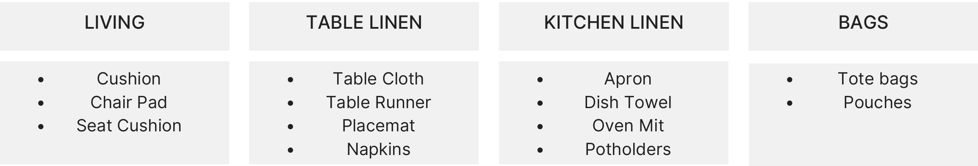
Product line introduction
Our major product range spans across living, table linen, kitchen linen, and bags, consciously designed to suit diverse global preferences. We bring in a variety of weaves, prints, and embroidery, offering products that range from subtle and minimal to bright and bold.
Our products are further enhanced with different washes and finishes, based on requirements, creating a unique look and feel.

Slide 15
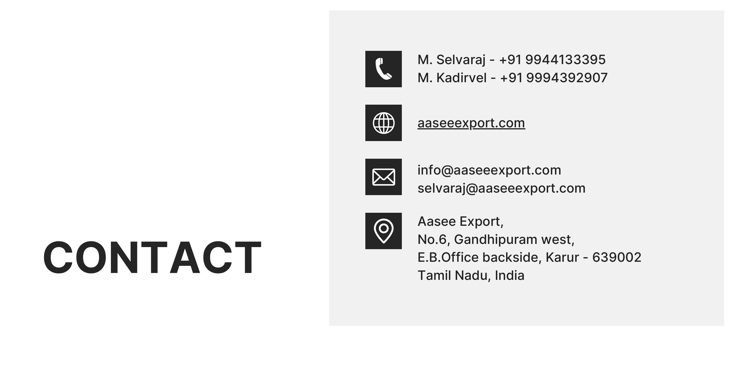
Contact us
Sakthi Sree Devi K - +91 9500583445
sakthi@aaseeexport.com

